Slide 1
Offshore vessel updates
Marine Affairs
September 2021

Slide 2
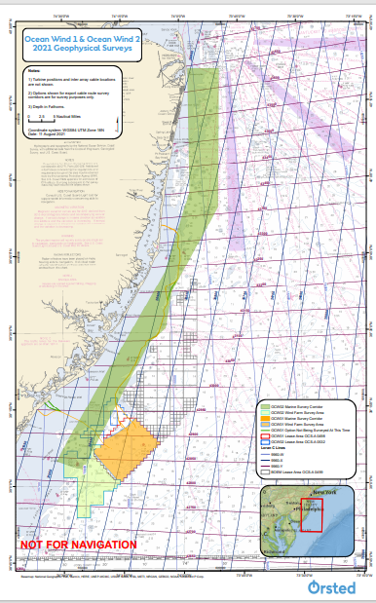
Ocean Wind 1 & Ocean Wind 2 NJ
OCW01 – NOI issued from BOEM to start environmental review
GP survey activity has concluded for this season
No current plans for GT surveys this year
OCW02 – project awarded by NJ BPU
2 GP survey vessel actively operating
Cable route
Lease area
1 GT survey vessel expected to come on site in October

Slide 3
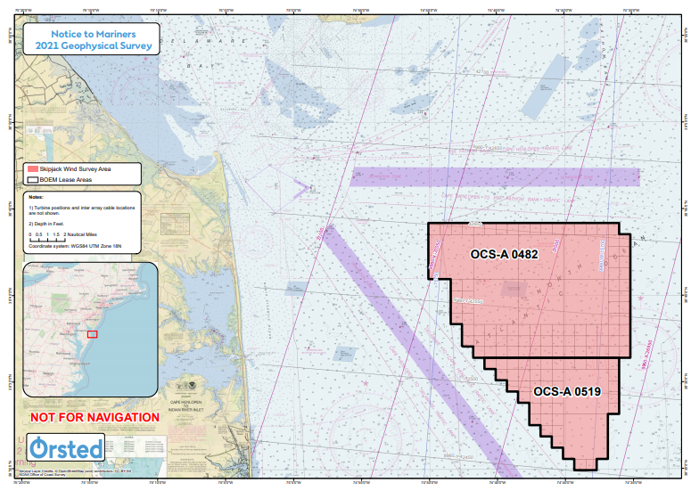
Skipjack Wind MD/DE
120 MW project awarded
Submitted bid for up to an additional 760 MW of power
Bid is under PSC review
Award expected Dec 2021
3 GP survey vessels active for project
1 offshore in lease area
2 nearshore along project cable route options
3 GT survey vessels scheduled for fall
1 currently active offshore
2 will come online in October
2 benthic surveys
Inshore Indian River
Offshore in lease area and along project cable route options
Notes:
Nearshore survey vessels work 12 hour days, based out of Cape May, NJ
1 is a US flagged vessel
1 vessel in OCW02 will need to complete a scope it was working on in SJW before the end of the season
GT surveys will utilize 2 US flagged vessels

